Slide 1
Natural Language Processing, Deep Nets, Linear Algebra and Information Retrieval
Kenneth Church
Northeastern University
k.church@northeastern.edu
Wednesday, June 21
https://github.com/kwchurch/JSALT_Better_Together

Slide 2
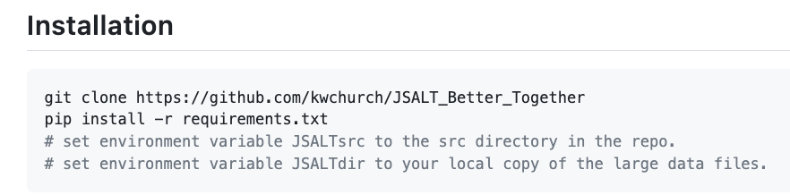
GitHub https://github.com/kwchurch/JSALT_Better_Together
Slides
https://github.com/kwchurch/JSALT_Better_Together/tree/main/slides/June21
Exercises
https://github.com/kwchurch/JSALT_Better_Together/tree/main/doc/exercises
Code
https://github.com/kwchurch/JSALT_Better_Together

Slide 3
Exercises (Lab for for this afternoon) https://github.com/kwchurch/JSALT_Better_Together/tree/main/doc/exercises
Simple usage of
Semantic Scholar’s API
Input: paper ids
Outputs: titles, abstracts, more ids, references, citations, embeddings
Models on HuggingFace
Input: titles + abstracts
Output: vectors (embeddings)
Citing Sentences
Dimension Reduction (Singular Value Decomposition (SVD))
Reduce BERT vectors from 768 dimensions to 2 dimensions (for plotting)
Replicate the centroid assumption
Centroid Assumption: vector of a doc is close to centroid of its references
Cite Prediction Challenge (Good Luck!)

Slide 4
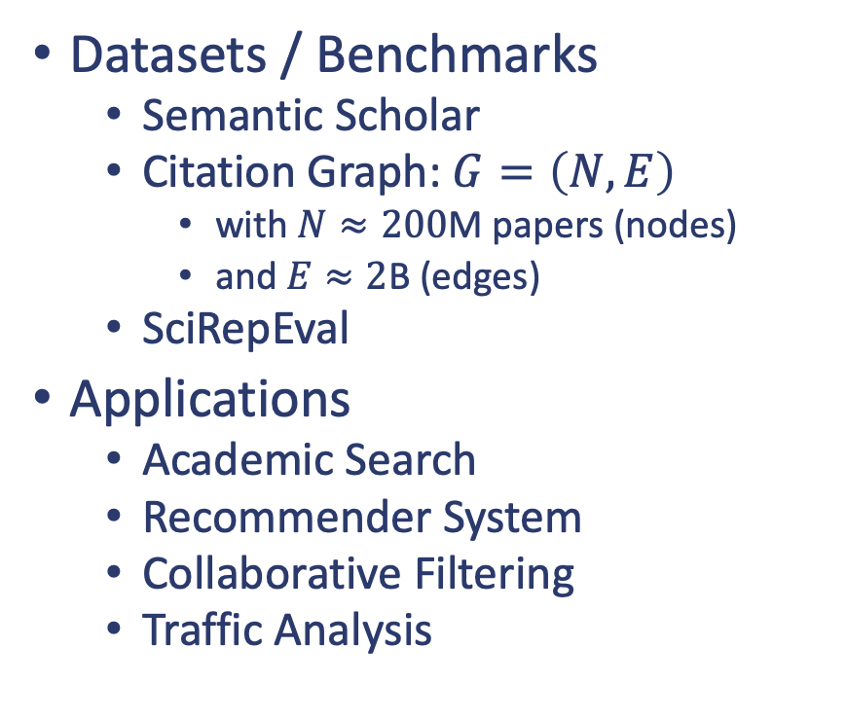
Introduction
Research Areas
Natural Language Processing (NLP)
Deep Nets (BERT)
Inference, Fine-tuning, Pretraining
Linear Algebra
Singular Value Decomposition (SVD)
Spectral Clustering
Information Retrieval (IR)
Datasets / Benchmarks
Semantic Scholar
Citation Graph: $G=\left(N, E\right)$
with $N≈200$M papers (nodes)
and $E≈2$B (edges)
SciRepEval
Applications
Academic Search
Recommender System
Collaborative Filtering
Traffic Analysis

Slide 5
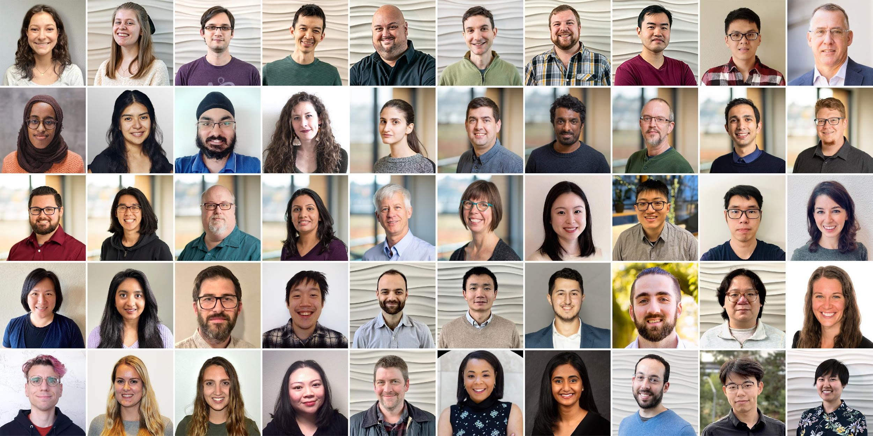
Semantic Scholar: Significant Effort (slide from Dan Weld)
50 person team
7 year project
207M+ scientific paper index
8M+ monthly active users

Slide 6
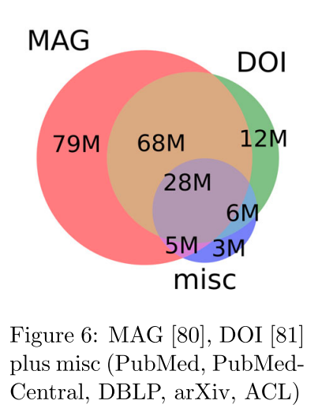
Semantic Scholar
Seven Sources
Fields of Study
Medicine (45M) | Engineering (8M) | Business (4M) | Geology (3M)
Chemistry (13M) | Physics (7M) | Sociology (3M) | History (2M)
Computer Science (13M) | Psychology (7M) | Geography (3M) | Art (2M)
Biology (13M) | Mathematics (5M) | Economics (3M) | Philosophy (1M)
Materials Science (10M) | Political Science (4M) | Environmental Science (3M)

Slide 7



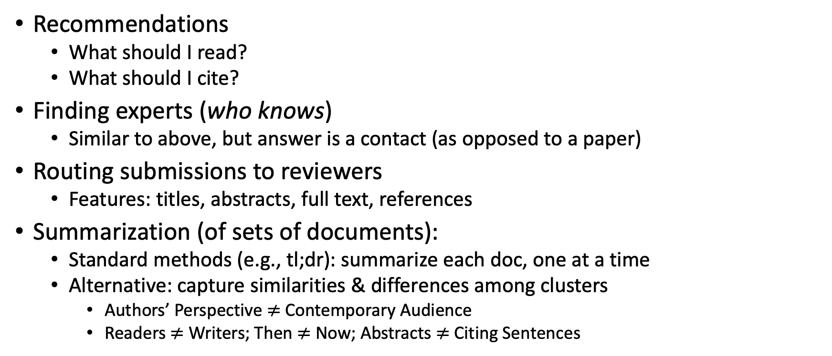
Document Similarities: Use Cases
Recommendations
What should I read?
What should I cite?
Finding experts (who knows)
Similar to above, but answer is a contact (as opposed to a paper)
Routing submissions to reviewers
Features: titles, abstracts, full text, references
Summarization (of sets of documents):
Standard methods (e.g., tl;dr): summarize each doc, one at a time
Alternative: capture similarities & differences among clusters
Authors’ Perspective $≠$Contemporary Audience
Readers $≠$ Writers; Then $≠$ Now; Abstracts $≠$ Citing Sentences

Slide 8

Better Together: Text (Titles, Abstracts, Body); Context (Citations)

Slide 9
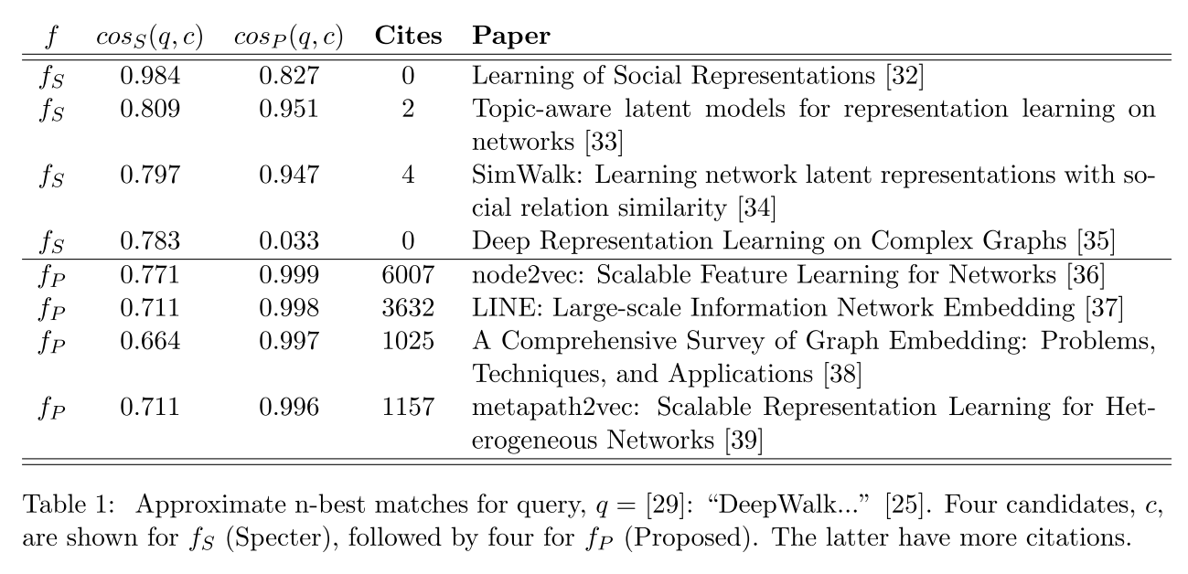
Query: ``DeepWalk: Online Learning of…’’

Slide 10
Document Similarities: Use Cases
Recommendations
What should I read?
What should I cite?
Many systems focus on ``relevance’’ (word overlap)
But we also want credibility
Don’t recommend papers that are buzz-word compliant
But not worth reading
(Most papers are never cited)

Slide 11
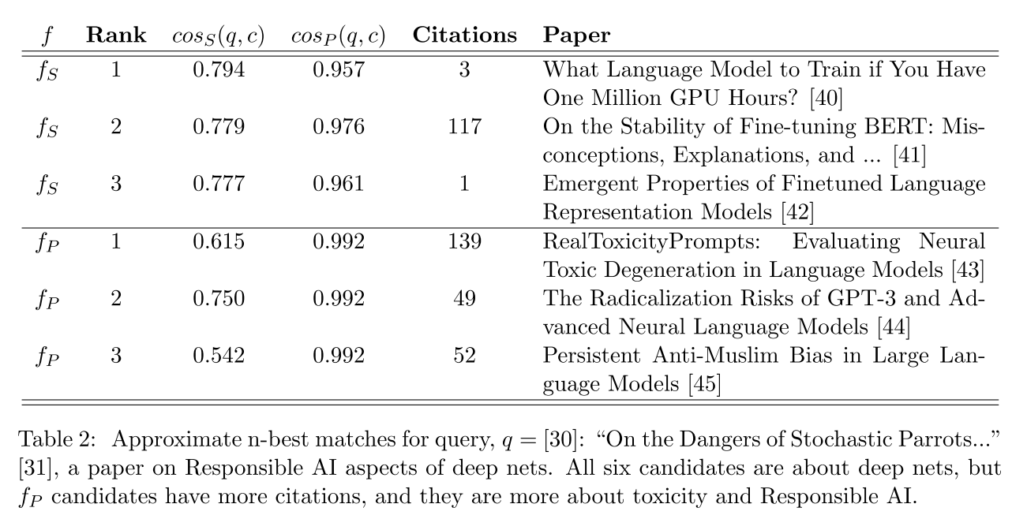
Query: ``On the Dangers of Stochastic Parrots…’’

Slide 12
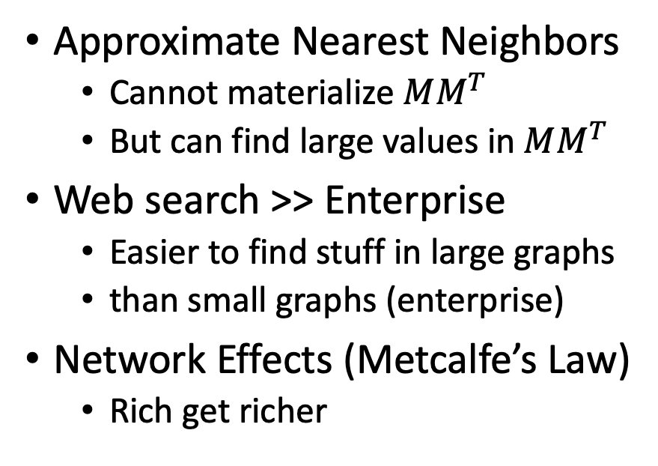
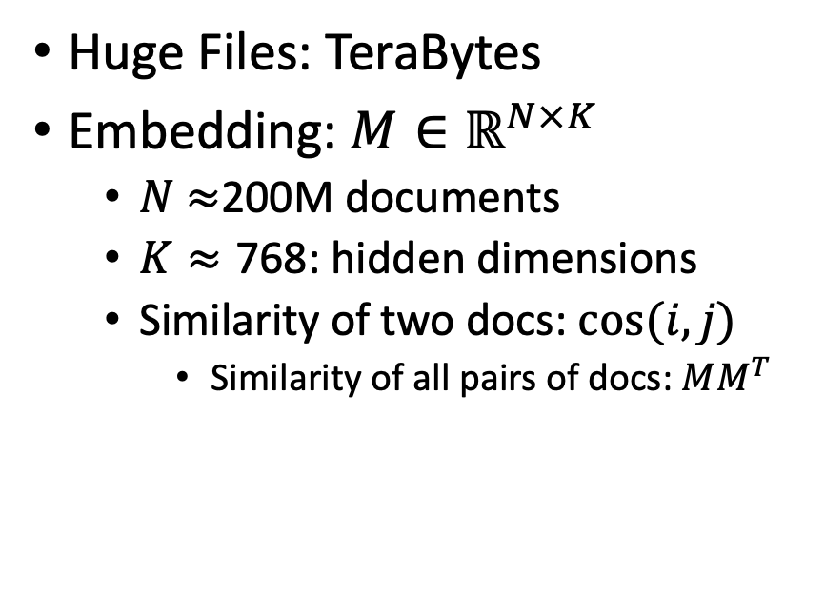
Scale: Both a Blessing and a Curse
Curse
Blessing
Huge Files: TeraBytes
Embedding: $M∈ℝ^{N×K}$
$N$ $≈$200M documents
$K≈\text{768}$: hidden dimensions
Similarity of two docs: $cos(i,j)⁡$
Similarity of all pairs of docs: $MM^{T}$
Approximate Nearest Neighbors
Cannot materialize $MM^{T}$
But can find large values in $MM^{T}$
Web search >> Enterprise
Easier to find stuff in large graphs
than small graphs (enterprise)
Network Effects (Metcalfe’s Law)
Rich get richer

Slide 13


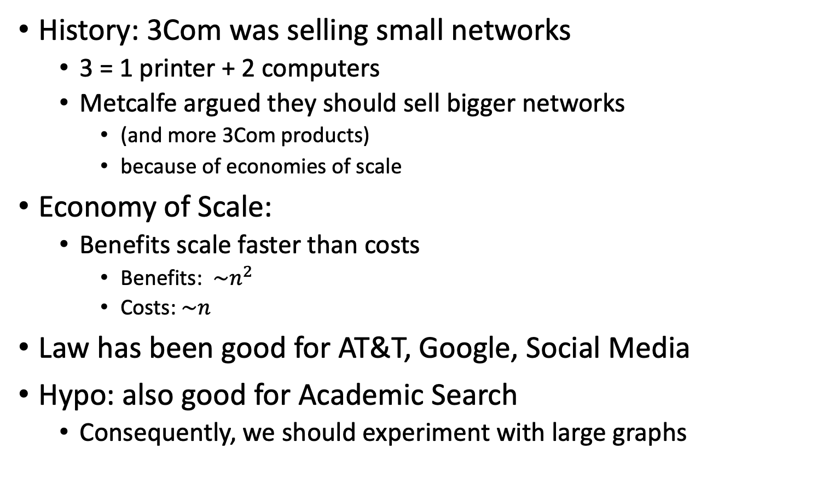
Metcalfe’s Law (Network Effects)
History: 3Com was selling small networks
3 = 1 printer + 2 computers
Metcalfe argued they should sell bigger networks
(and more 3Com products)
because of economies of scale
Economy of Scale:
Benefits scale faster than costs
Benefits: $\sim n^{2}$
Costs:$\sim n$
Law has been good for AT&T, Google, Social Media
Hypo: also good for Academic Search
Consequently, we should experiment with large graphs

Slide 14
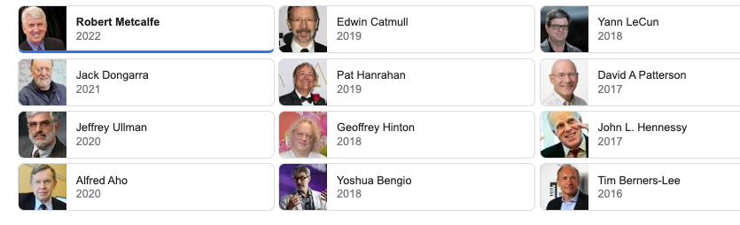
Turing Award/Winners

Slide 15
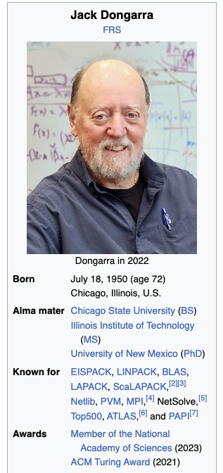
Turing Awards: Metcalfe’s Law, Deep Nets, Linear Algebra
Metclalfe’s Law: Metcalfe
Deep Nets: Hinton, Bengio, LeCun
Linear Algebra: Dongarra

Slide 16
Realities
The Real World
Idealizations (Evaluation Benchmarks)
Large (Metcalfe’s Law)
Growing
Dirty
Missing Values
Bad/misleading Values
Small
Static
Clean

Slide 17
Global Scientific Output Doubles Every 9 Years
Timeliness
Web companies keep indexes up to date (web is a moving target)
Ditto for Academic Search

Slide 18
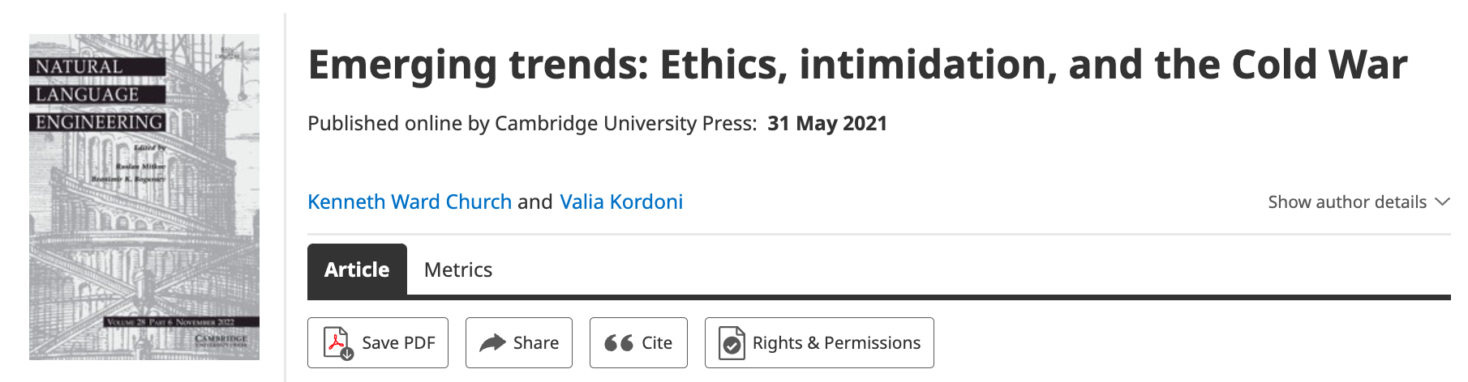
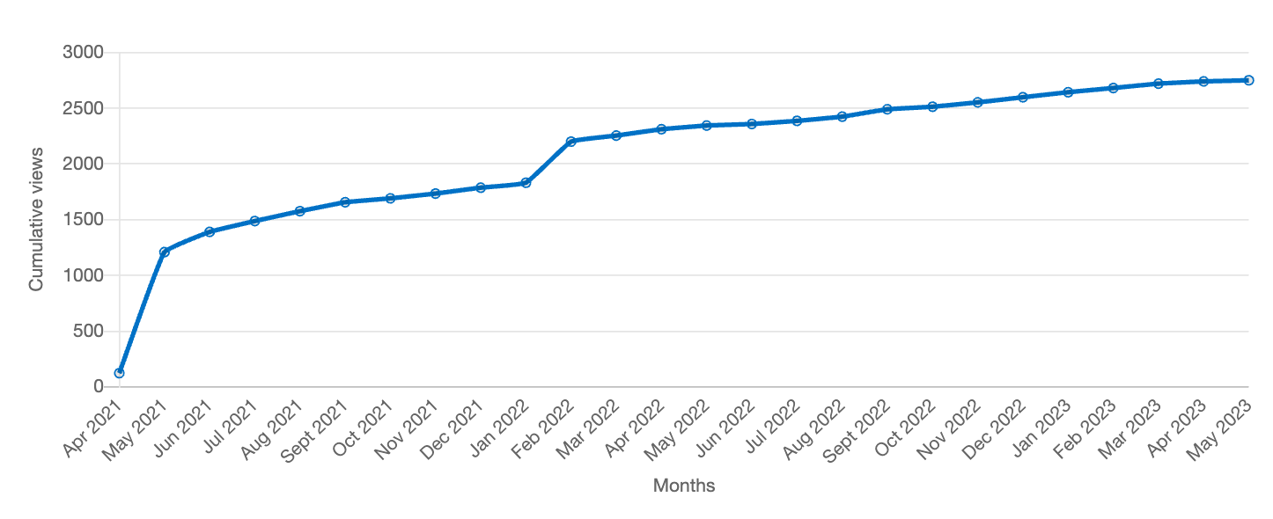
Value: Author Contributions + Audience Appreciation (Literature is a conversation, like social media)
Author Contributions
Time Invariant
Does not change after publication
Audience Appreciation
Evolves over time
Behavioral Signals
Views
Citations

Slide 19
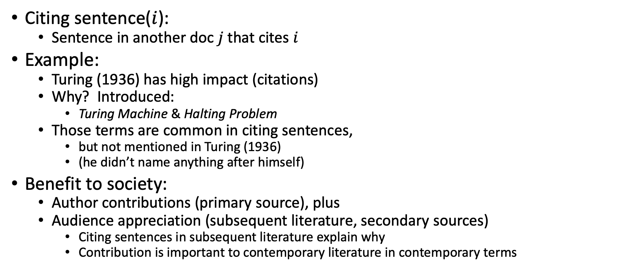
Citing Sentences
Citing sentence($i$):
Sentence in another doc $j$that cites $i$
Example:
Turing (1936) has high impact (citations)
Why? Introduced:
Turing Machine & Halting Problem
Those terms are common in citing sentences,
but not mentioned in Turing (1936)
(he didn’t name anything after himself)
Benefit to society:
Author contributions (primary source), plus
Audience appreciation (subsequent literature, secondary sources)
Citing sentences in subsequent literature explain why
Contribution is important to contemporary literature in contemporary terms
Anchor Text in Web Search

Slide 20
Why are some papers cited more than others?
Example: Word2Vec
Word2vec is not
the first, last or best
to discuss
vector spaces, embeddings, analogies, similarity metrics, etc.
But word2vec is simple and accessible.
Anyone can download the code and use it in their next paper.
Any many do (for better and for worse).

Slide 21
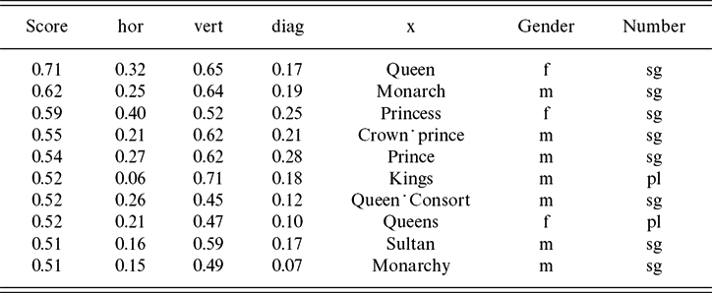
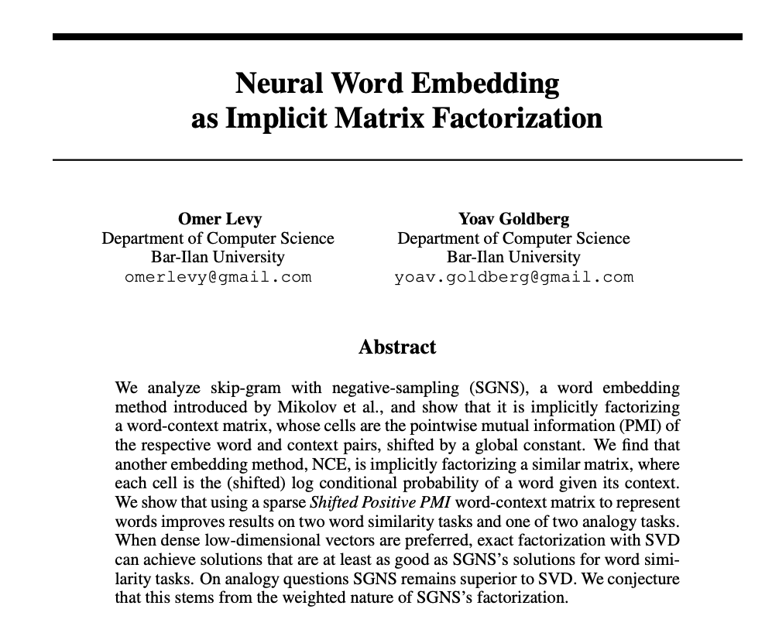
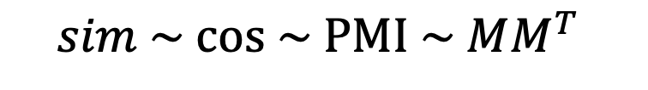
Word2Vec: Analogies
man is to woman
as king is to ???
Vector
Vector
Vector
cos
Paradigm Shift:
Features → Word Associations
$$sim \sim cos \sim PMI \sim MM^{T}⁡$$

Slide 22
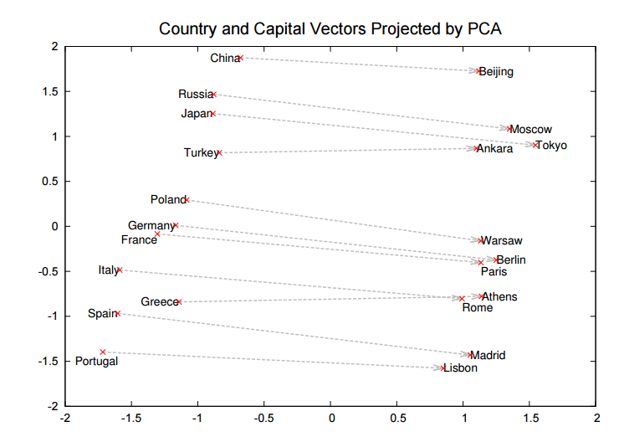
Word2Vec: More Promising Early Results
Countries
Capitals

Slide 23
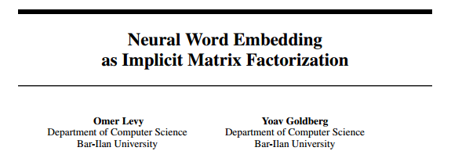
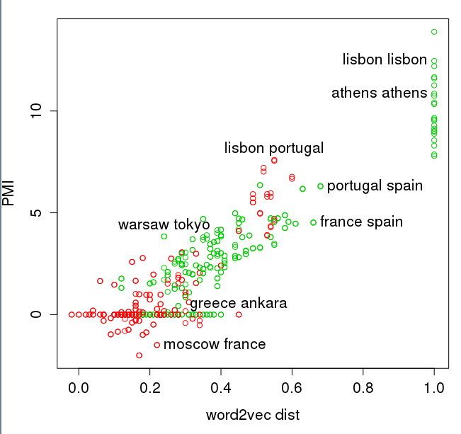
Levy & Goldberg (NIPS-2014) Word2Vec ≈ PMI (Pointwise Mutual Info)
Green → Type Match: Two Capitals or Two Countries
Red → Type Mismatch: A Capital and a Country

Slide 24
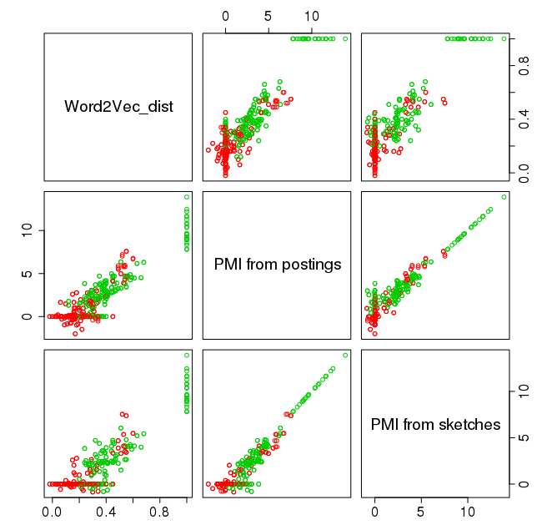
Levy & Goldberg (NIPS-2014) Word2Vec ≈ PMI (too simple to be right)
pairs in R
Green → Type Match: Two Capitals or Two Countries
Red → Type Mismatch: A Capital and a Country

Slide 25
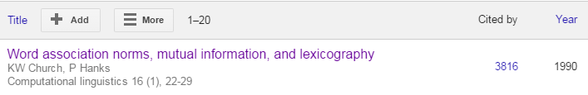
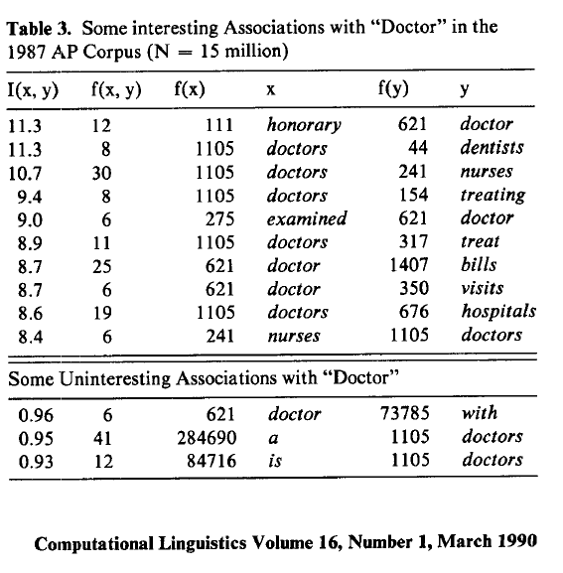
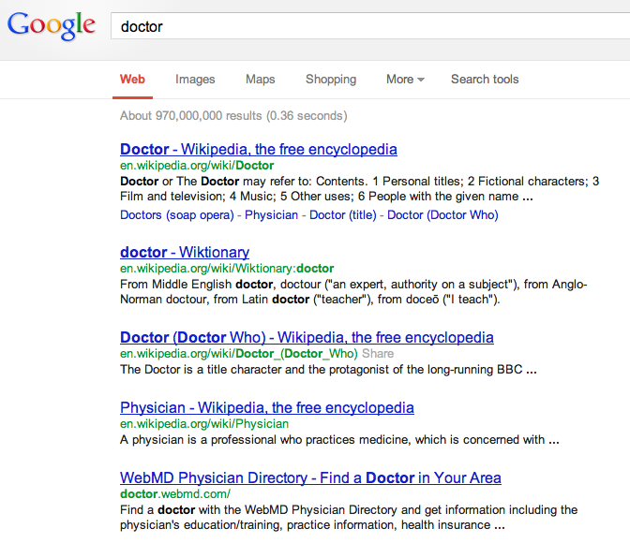
2016
Counts are growing 1000x per decade
(same as disks)
Counts are growing 1000x per decade
(same as disks)
Rising Tide of Data Lifts All Boats
Big Data →
Opportunities & Challenges

Slide 26
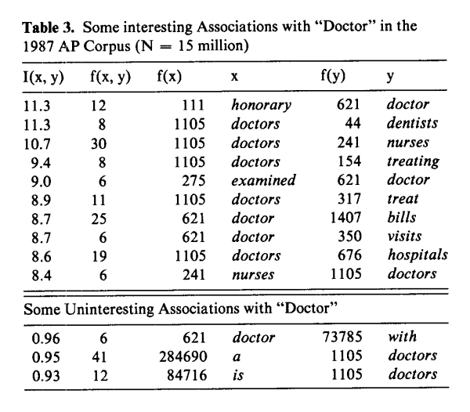
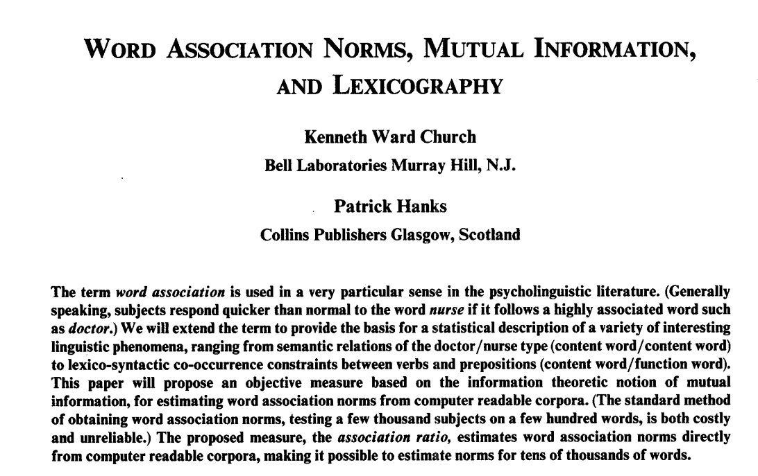
PMI: Interdisciplinary Combination of Empirical Methods from 1950s: Psycholinguistics, Information Theory, etc.
Word Associations: Doctor/Nurse
PMI (Pointwise Mutual Information)
``You shall know a word by the company it keeps’’ (Firth, 1957)

Slide 27


Paradigm Shifts
https://plato.stanford.edu/entries/thomas-kuhn/
Two conditions:
A few initial (promising, if not convincing) successes
that motivate early adopters (students) to do more, as well as
Leave room for early adopters to contribute and benefit by doing so.
Promising >> Convincing
ChatGPT is discouraging some students
Who think it is better than it is

Slide 28
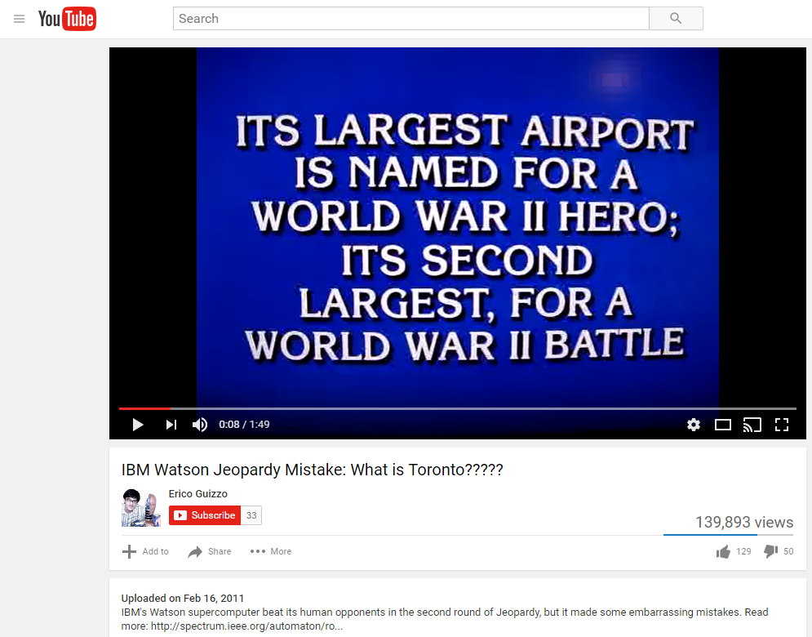
Promising >> Convincing To err is human, to really foul things up requires a computer
IBM Watson Jeopardy Mistake
Category: US Cities
Computer Error:
Toronto
Computer Error → ``Hallucination’’

Slide 29
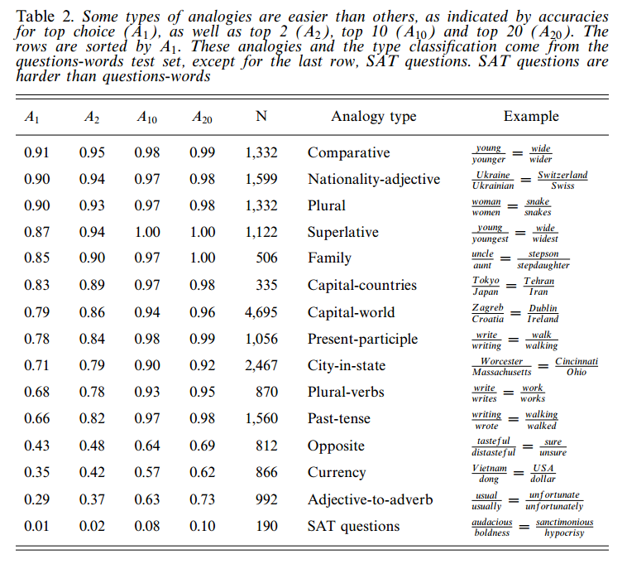
Evaluation: What you measure is what you get Word2vec: question-words >> SAT
⚠️ ⚠️ ⚠️ Warning ⚠️ ⚠️ ⚠️
Iffy Eval →
Unrealistic Expectations →
AI Winter
Question-words

Slide 30
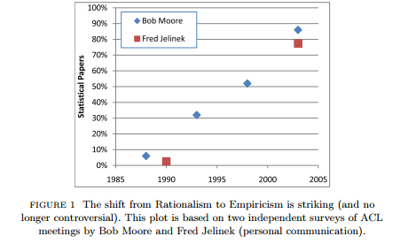
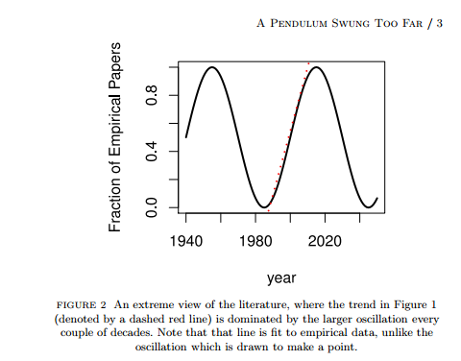
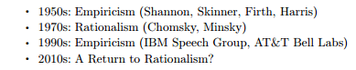
Grandparents and grandchildren have a natural alliance
⚠️ ⚠️ ⚠️ Warning ⚠️ ⚠️ ⚠️
Unrealistic Expectations → Winter
⚠️ ⚠️ ⚠️ Warning ⚠️ ⚠️ ⚠️
Unrealistic Expectations → Winter

Slide 31
Farce in Three Acts https://www.earningmyturns.org/2017/06/a-computational-linguistic-farce-in.html
Rationalism (1970s)
Empiricism (1990s)
Deep Nets (2010s)

Slide 32
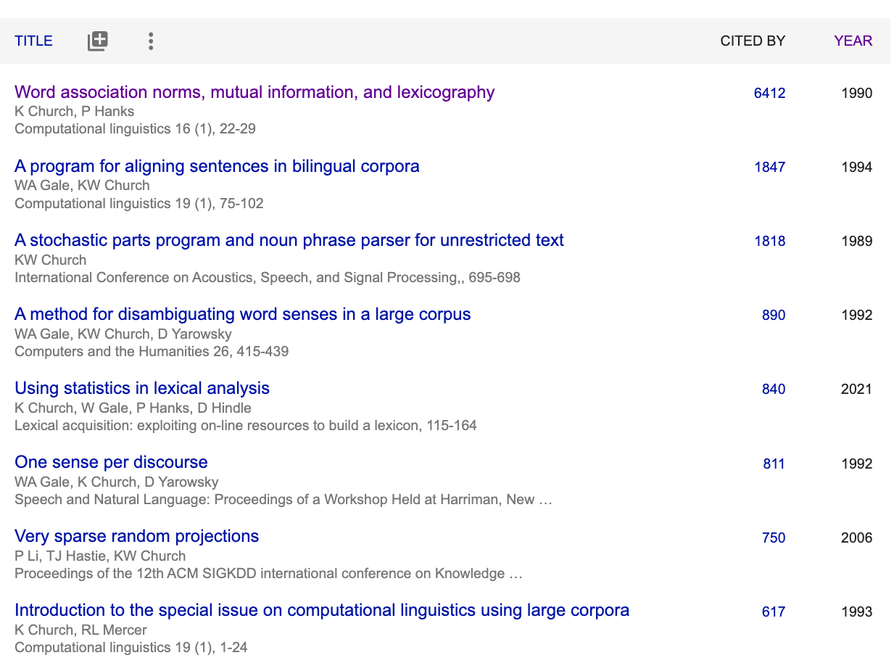
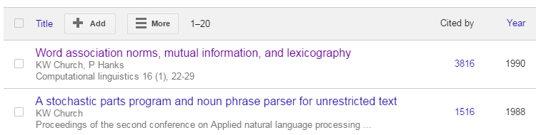
When I was a graduate student (just before AI Winter in 1980s)
2023
I was told that it was no longer possible to get a PhD in Syntax
Parsing had been declared “solved”
Even semantics was largely “solved”
I was told to go work on pragmatics
After graduating…
PMI
MT
ANN
2016
Revival of 1950s Empiricism

Slide 33
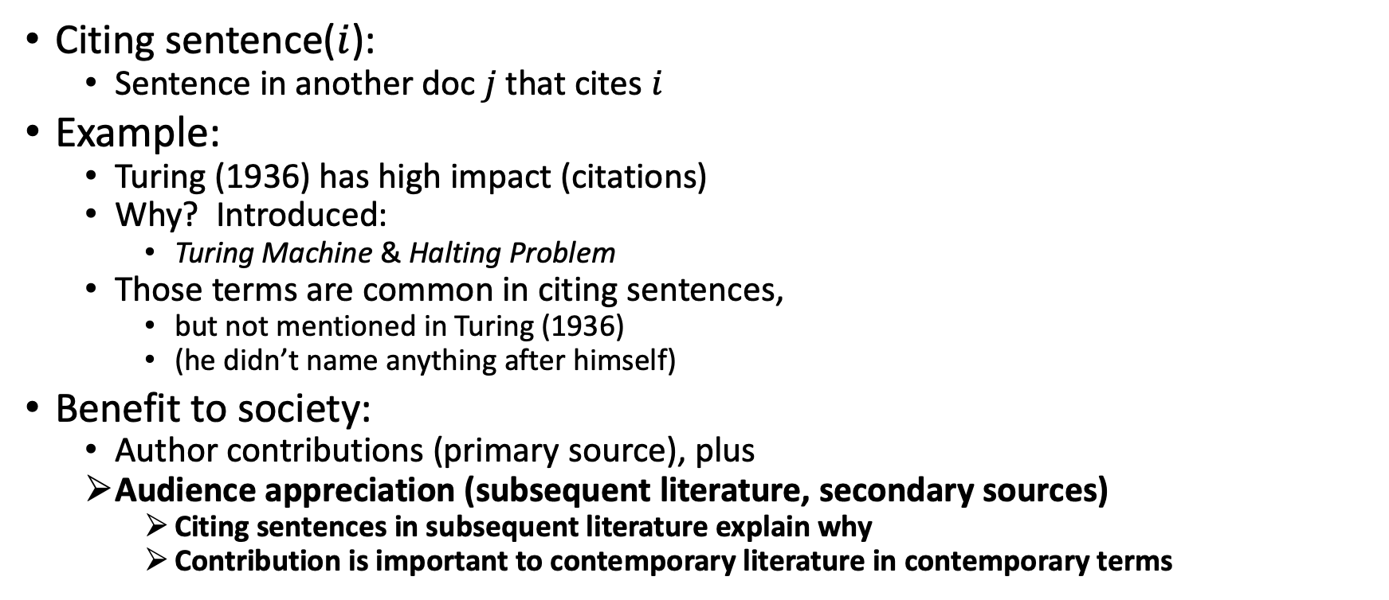
Citing Sentences (repeated slide)
Citing sentence($i$):
Sentence in another doc $j$that cites $i$
Example:
Turing (1936) has high impact (citations)
Why? Introduced:
Turing Machine & Halting Problem
Those terms are common in citing sentences,
but not mentioned in Turing (1936)
(he didn’t name anything after himself)
Benefit to society:
Author contributions (primary source), plus
Audience appreciation (subsequent literature, secondary sources)
Citing sentences in subsequent literature explain why
Contribution is important to contemporary literature in contemporary terms
Anchor Text in Web Search

Slide 34
Motivation for Revival of Empiricism in 1990s?
What were we rebelling against?
The revival was driven by pragmatic considerations.
The field had been banging its head on big hard challenges like
AI-complete problems and
long-distance dependencies.
We advocated a pragmatic pivot toward simple stuff
PMI (Pointwise Mutual Information)
Part of Speech Tagging
Aligning Parallel Corpora
Sketches & ANN (approx. nearest neigh)
Data was becoming available
like never before.
What can we do with all this data?
It is better to do something simple
(than nothing at all).
Let’s go pick some low hanging fruit.
Let’s do what we can with
short-distance dependencies.
That won’t solve the whole problem,
but let’s focus on what we can do
as opposed to what we can’t do.

Slide 35
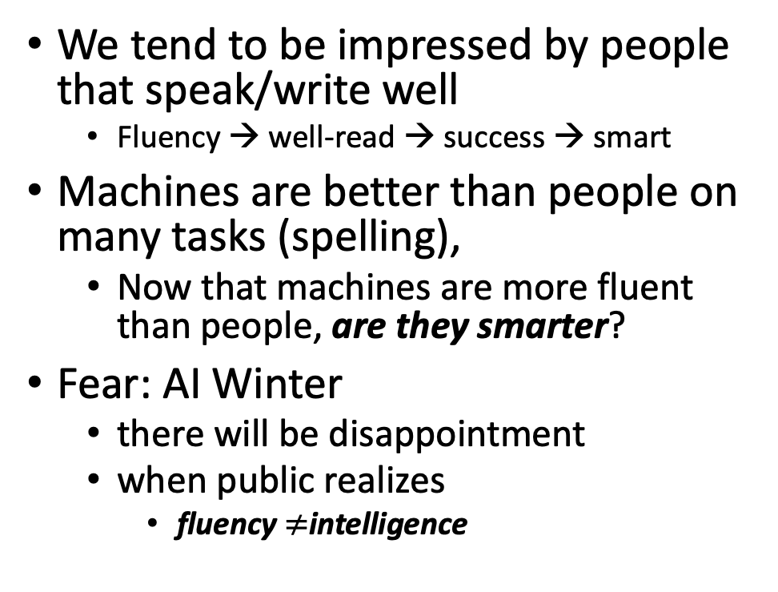
Part A: Glass is half full (deep nets can do much) Part B: Glass is half empty (always more to do)
https://github.com/kwchurch/ACL2022_deepnets_tutorial
Advocate combo of Part A with
AI Knowledge Representation
Linguistics and Philosophy
Pendulum Swung Too Far
There have been many AI Winters
Often, after ``irrational exuberance’’
(like current excitement with nets)
We tend to be impressed by people that speak/write well
Fluency → well-read → success → smart
Machines are better than people on many tasks (spelling),
Now that machines are more fluent than people, are they smarter?
Fear: AI Winter
there will be disappointment
when public realizes
fluency $≠$intelligence

Slide 36
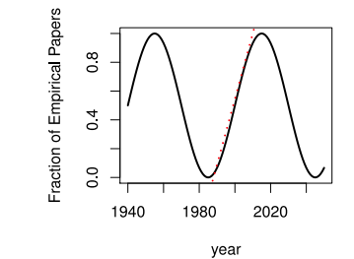
Large Language Models (LLMs) Strengths (1950s/1990s); Weaknesses (1970s)
Strengths (fluency)
1950s/1990s: Empiricism
Shannon, Skinner, Firth, Harris
You shall know a word by the company it keeps (Firth, 1957)
Collocations (Easy for Machines)
Distributional Hypothesis (Zellig Harris):
find patterns (more freq than chance)
no meaning (semantics), syntax, truth
PMI, Word2Vec, BERT
Weaknesses (Hallucinations)
1970s: Rationalism
Chomsky, Minsky
Truth (Hard for Machines)
logical form
temporal/spatial logic
possible worlds
Meaning
Purpose (Planning/Discourse)
Common Sense Knowledge

Slide 37
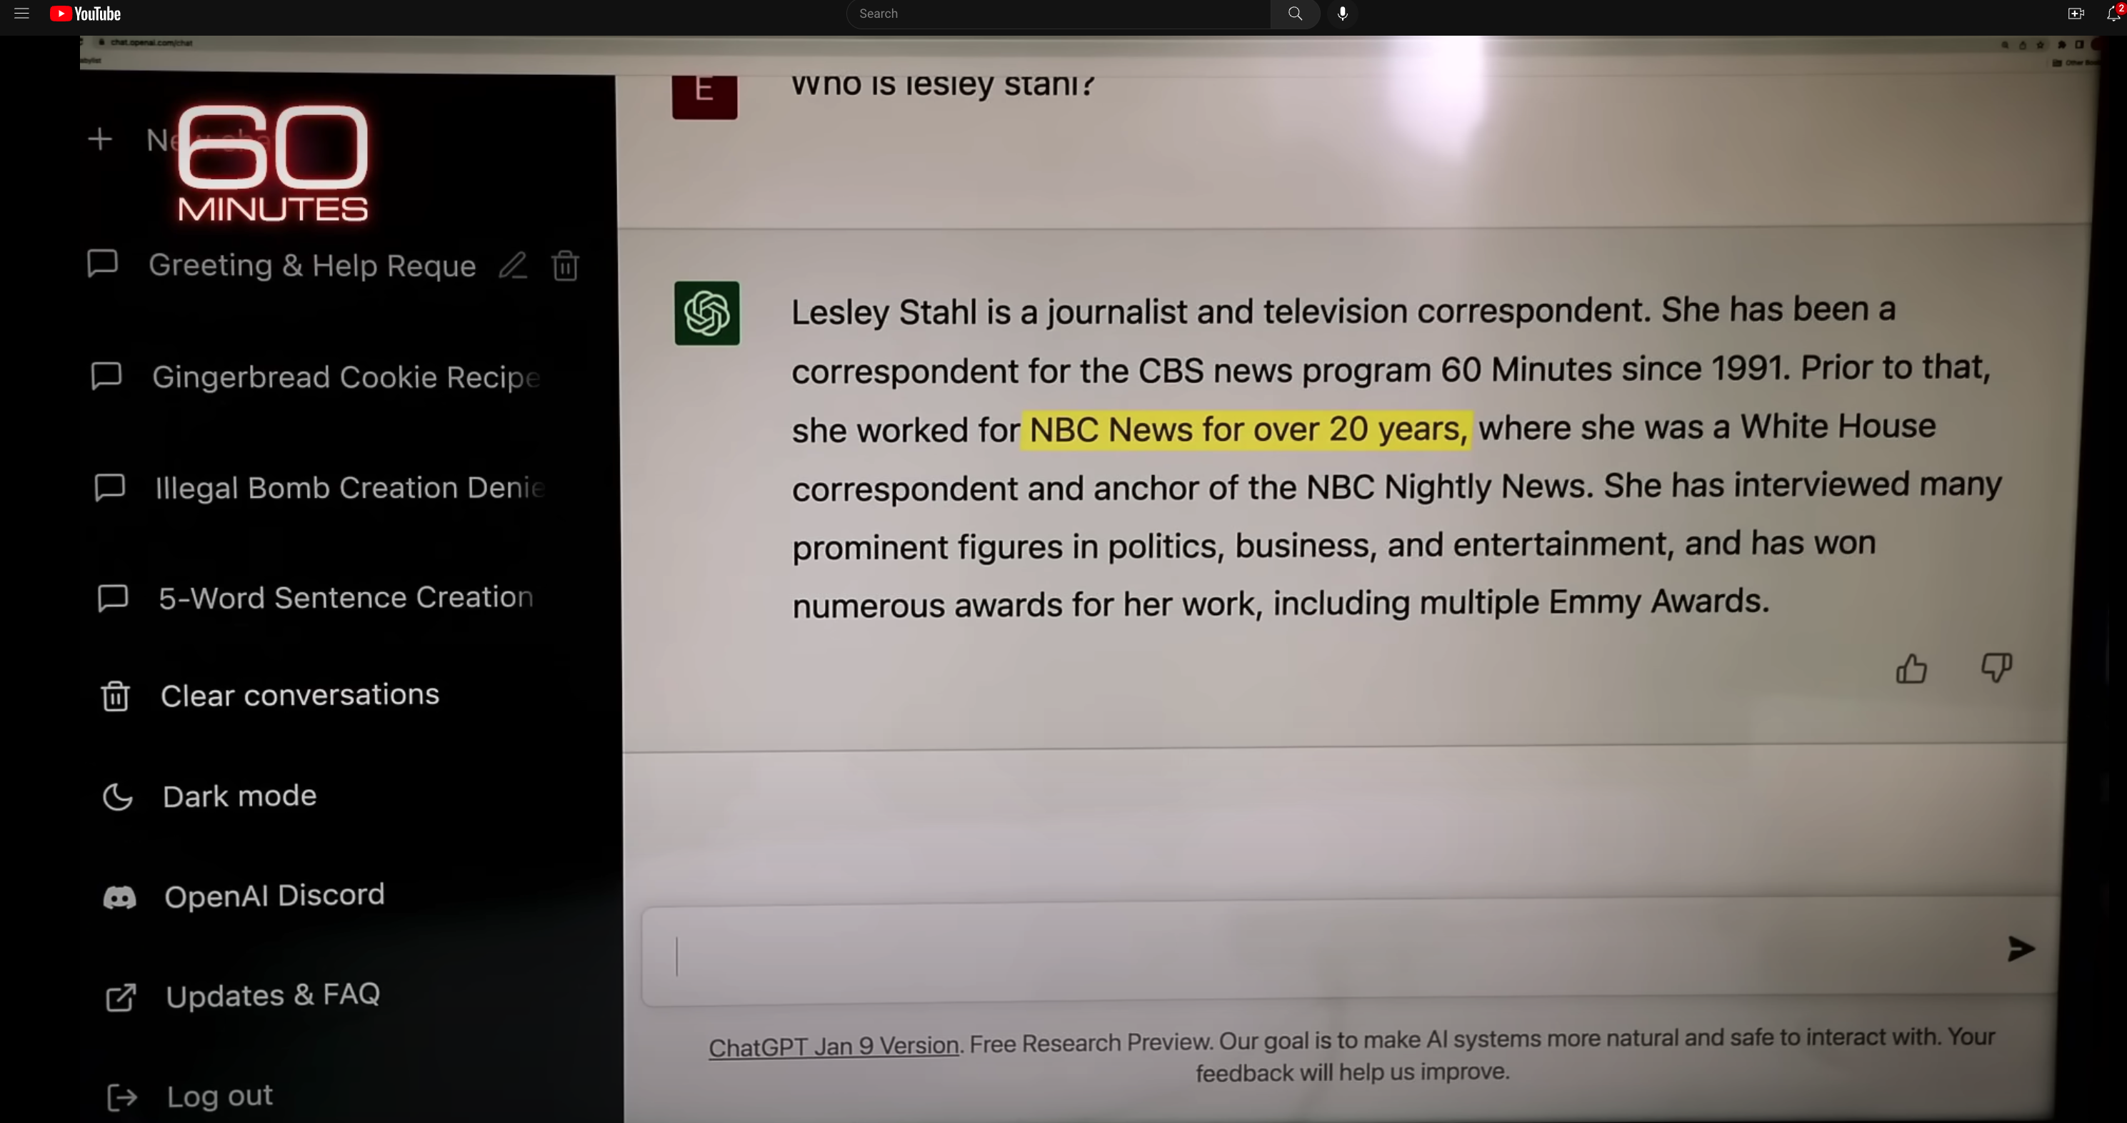
Hallucinations
Prompt
Language models
make up ``alternative facts’’
faster than fact-checking
Dangerous failure mode
People will believe these ``alternative facts’’
Hallucination
ChatGPT Hallucinates on CBS ``60 Minutes’’ https://www.youtube.com/watch?v=1wzPr4cUoMQ&t=463s
https://github.com/kwchurch/ACL2022_deepnets_tutorial
37

Slide 38
Positive Opportunities for Machine Translation
Technology is good enough
that I could work for Baidu
even though my Chinese
is worse than my French
Functionality
Inputs: language → phones
camera, microphone, QR codes, net
documents (html, pdf, ppt, xls)
Outputs: phones → language
screen, speaker, net, etc.
Requirements: fluency, credibility, latency
Widely deployed (in China)
Everywhere: Hotels, taxis, shops, etc.
Anyone with a phone (everyone)
Knows how to use this stuff
Metrics suggest
Technology is better than humans
But I am more productive
with a human interpreter
Metrics are wrong: BLEU & latency
Human interpreters emphasize
What I need to know
When I need to know it
Machines translate
Everything (with equal emphasis)
I don’t trust machines (with terminology):
``ecology’’ vs ``eco-system’’
``corruption’’
It is exhausting second-guessing machines

Slide 39
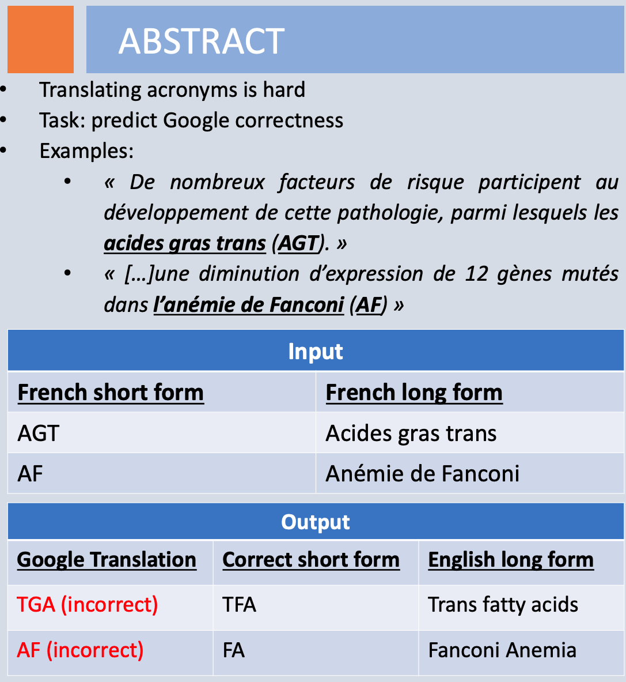
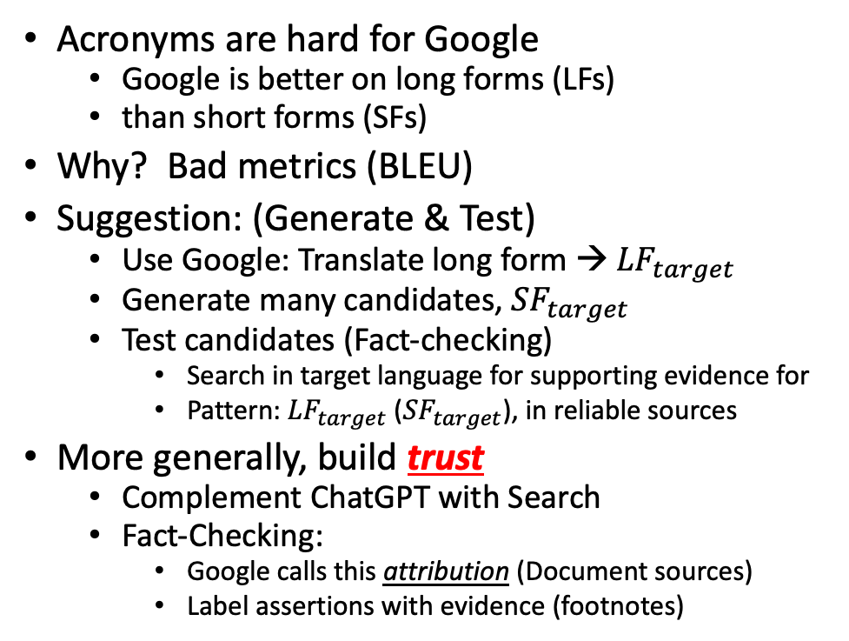
Mismatch Between Translators & Engineers: Technical Terminology
Richard Yue
Acronyms are hard for Google
Google is better on long forms (LFs)
than short forms (SFs)
Why? Bad metrics (BLEU)
Suggestion: (Generate & Test)
Use Google: Translate long form → ${LF}_{target}$
Generate many candidates, ${SF}_{target}$
Test candidates (Fact-checking)
Search in target language for supporting evidence for
Pattern: ${LF}_{target}$ (${SF}_{target}$), in reliable sources
More generally, build trust
Complement ChatGPT with Search
Fact-Checking:
Google calls this attribution (Document sources)
Label assertions with evidence (footnotes)
Hallucinations

Slide 40
Hypo: Contribution = Primary + Secondary Literature
Contribution
Author Contributions: Primary Literature
Audience Appreciation: Secondary Sources (Surveys, Textbooks, Social Media, etc.)
Examples:
Cold War Opinion Piece: World Events → More Views
PMI: Subsequent work (Word2Vec/BERT) → More Citations
Rising tide lifts all boats

Slide 41
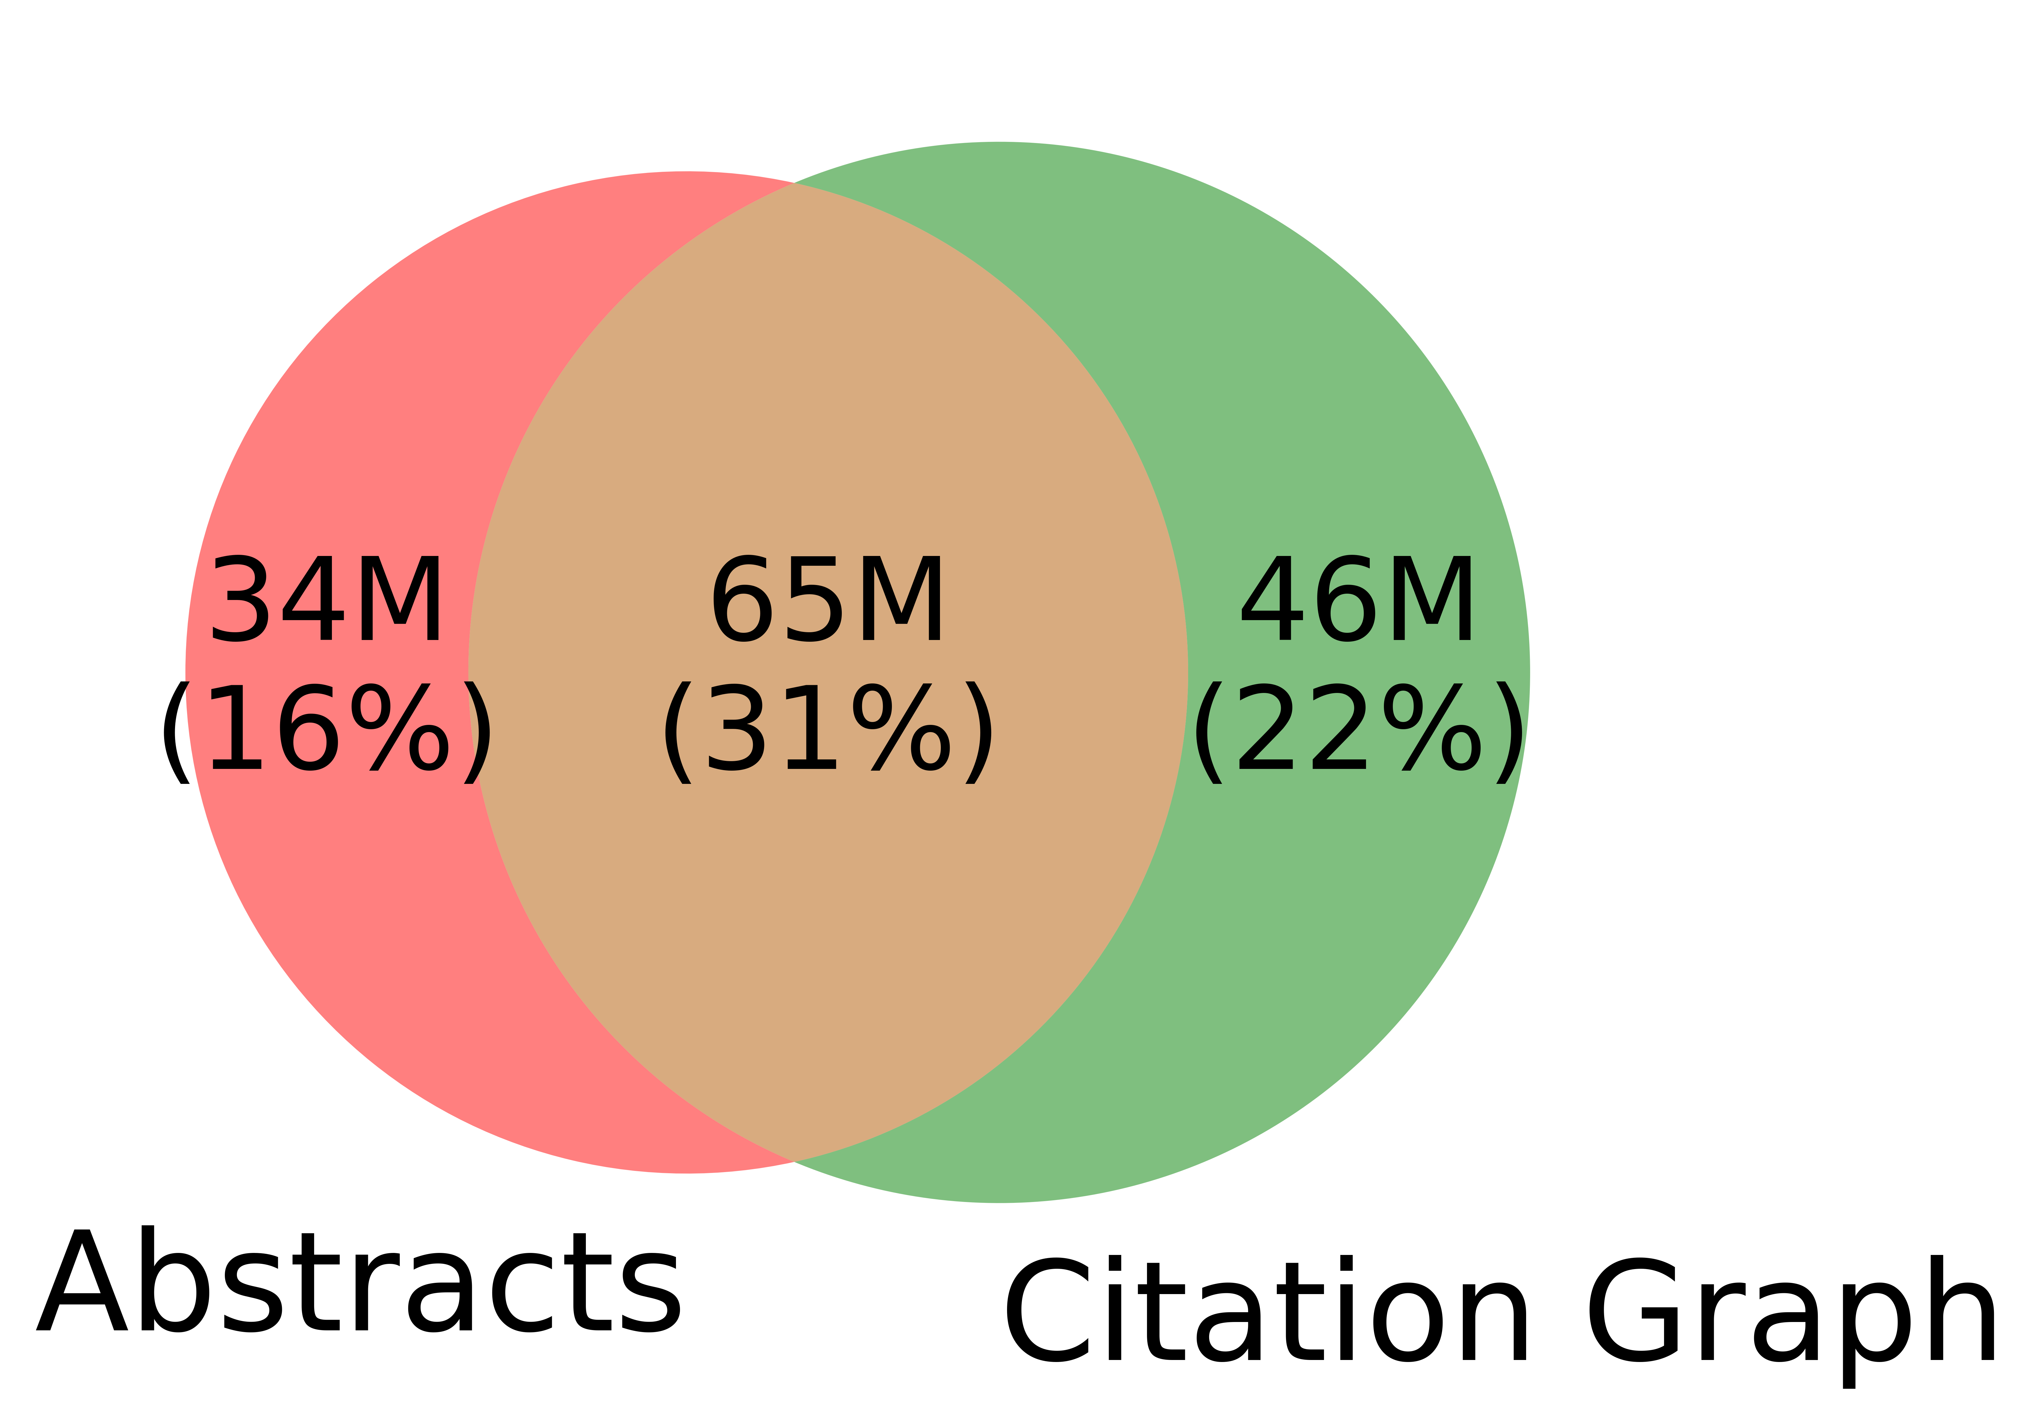
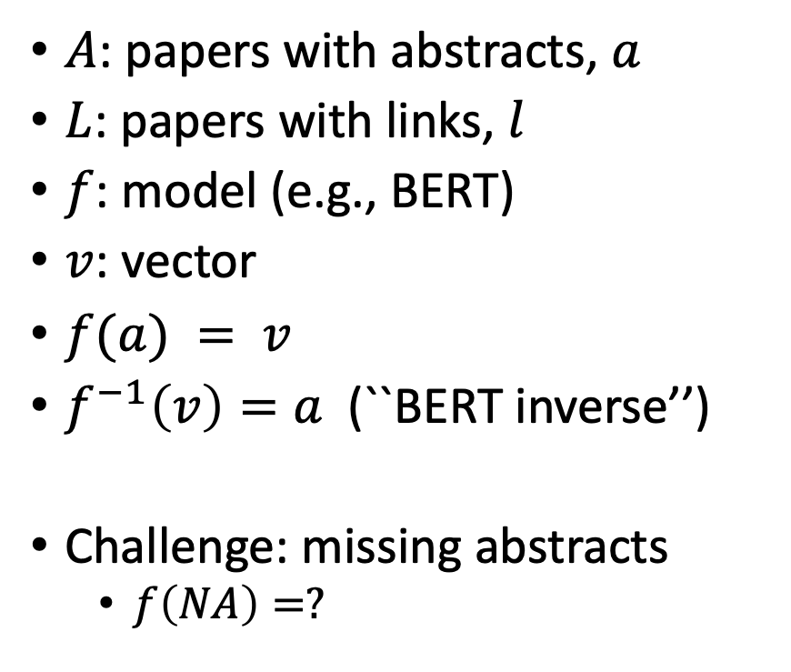
Realities: Missing Values
$A$: papers with abstracts, $a$
$L$: papers with links, $l$
$f$: model (e.g., BERT)
$v$: vector
$f(a) = v$
$f^{−1}\left(v\right)=a$(``BERT inverse’’)
Challenge: missing abstracts
$f\left(NA\right)=?$

Slide 42
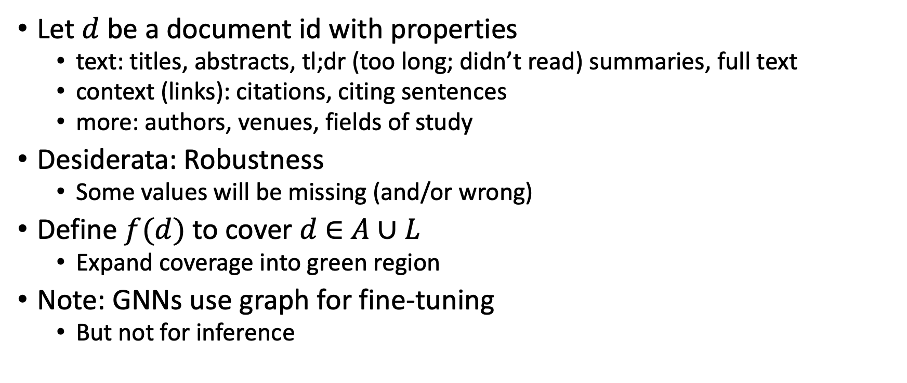

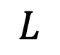
Suggestion for Missing Values
Let $d$ be a document id with properties
text: titles, abstracts, tl;dr (too long; didn’t read) summaries, full text
context (links): citations, citing sentences
more: authors, venues, fields of study
Desiderata: Robustness
Some values will be missing (and/or wrong)
Define $f(d)$ to cover $d$ $∈$ $A∪L$
Expand coverage into green region
Note: GNNs use graph for fine-tuning
But not for inference
$$A$$
$$L$$

Slide 43
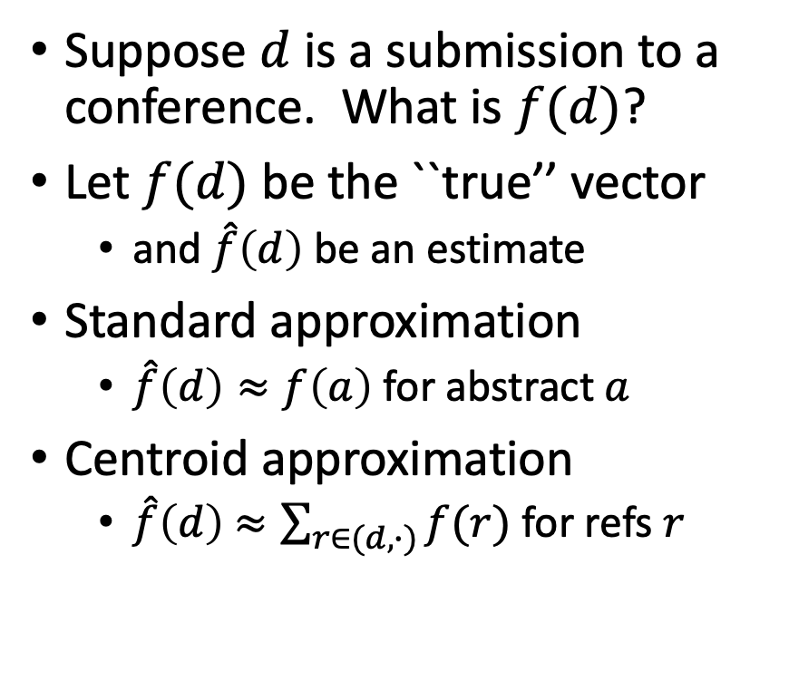
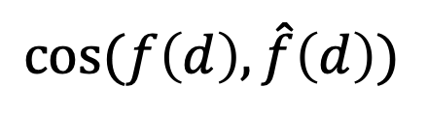
Centroid Assumption
Evidence for Centroid Approximation
Suppose $d$ is a submission to a conference. What is $f(d)$?
Let $f(d)$ be the ``true’’ vector
and $\hat{f}\left(d\right)$ be an estimate
Standard approximation
$\hat{f}\left(d\right)≈f\left(a\right)$ for abstract $a$
Centroid approximation
$\hat{f}\left(d\right)$ $≈\sum_{r∈(d,∙)}{f(r)}$ for refs $r$
$$cos⁡(f\left(d\right), \hat{f}\left(d\right))$$

Slide 44
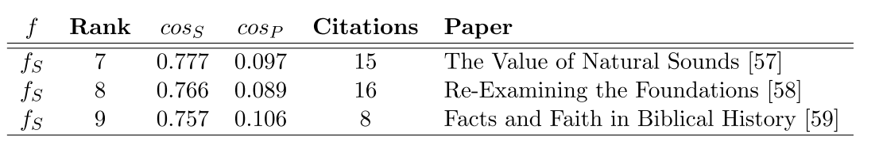
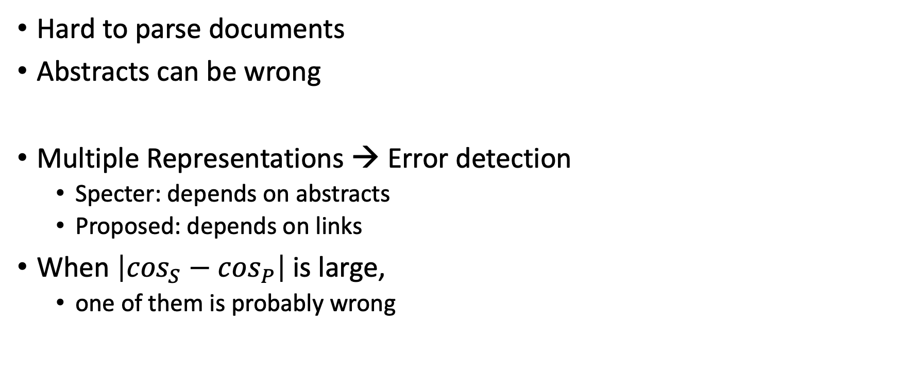
Bad/Misleading Values: Redundancy → Robustness
Hard to parse documents
Abstracts can be wrong
Multiple Representations → Error detection
Specter: depends on abstracts
Proposed: depends on links
When $\left|\cos_{S}−\cos_{P}\right|$is large,
one of them is probably wrong

Slide 45


Rank | Specter | Proposed | Paper
query | 1.000 | 1.000 | 1097: On stress and linguistic rhythm
1 | 0.908 | 0.926 | 0: Linguistic Society of America Structure and Intonation
2 | 0.895 | 0.977 | 475: Preliminaries to linguistic phonetics
3 | 0.885 | 0.921 | 25: Linguistic Society of America On the Definition of Word by
4 | 0.881 | 0.763 | 37: On some defferences between Chinese and Japanese '-Wh'-elements
5 | 0.880 | 0.946 | 2: Some accentuation properties in Japanese and lexical phonology
6 | 0.865 | 0.824 | 6: Two Types of Zi-Verbs in Japanese
7 | 0.777 | 0.097 | 15: The Value of Natural Sounds
8 | 0.766 | 0.089 | 16: Re-Examining the Foundations
9 | 0.757 | 0.106 | 8: Facts and Faith in Biblical History
1 | 0.578 | 0.998 | 226: The phonology of rhythm in English
2 | 0.530 | 0.997 | 74: A grid-based theory of English meter
3 | -1.000 | 0.996 | 5: "What does Phonology tell us about Stress and Rhythm? Some Reflections on the Phonology of Stress"
4 | 0.460 | 0.994 | 1: Syllable structure and stress in Bahdinani Kurdish
5 | 0.442 | 0.994 | 35: Schwa in phonological theory
6 | -1.000 | 0.994 | 163: The Sound Pattern of Russian: A Linguistic and Acoustical Investigation
7 | 0.542 | 0.993 | 27: Empirical evidence for a deletion formulation of the rhythm rule in English
8 | 0.552 | 0.993 | 95: Prosodic Structure Above the Word
9 | 0.334 | 0.993 | 0: Syllable Contraction in Cantonese A-not-A Constructions: An Optimality Account

Slide 46
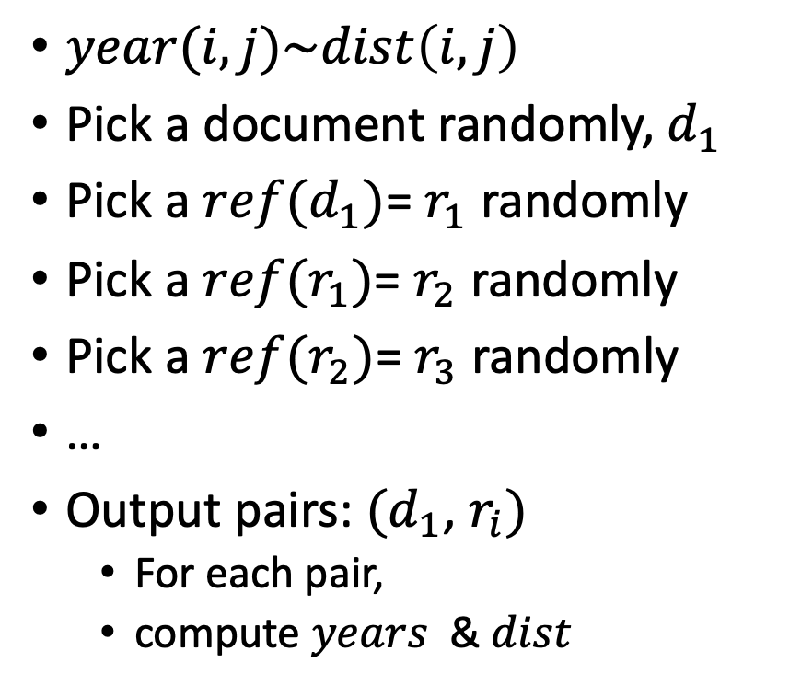
Random Walks
$year(i,j)\sim dist\left(i,j\right)$
Pick a document randomly, $d_{1}$
Pick a $ref(d_{1})$= $r_{1}$ randomly
Pick a $ref(r_{1})$= $r_{2}$ randomly
Pick a $ref(r_{2})$= $r_{3}$ randomly
…
Output pairs: $(d_{1}$, $r_{i})$
For each pair,
compute $years⁡$ & $dist$

Slide 47
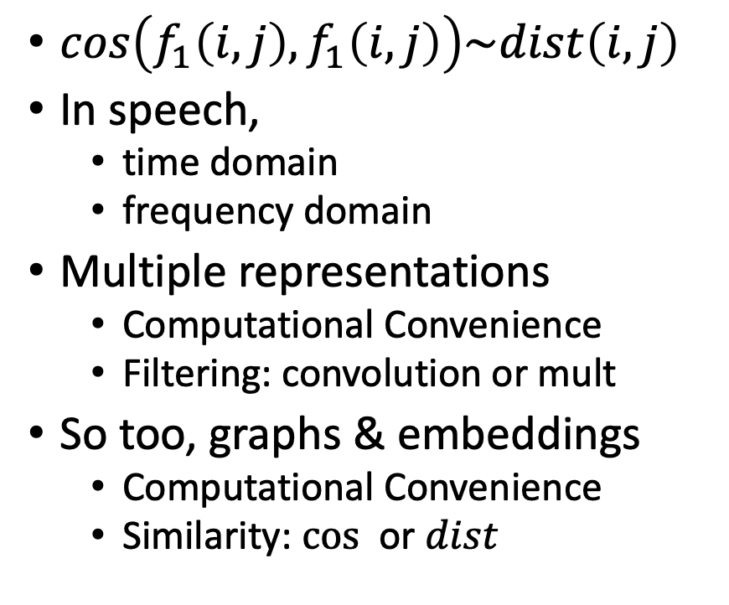
Cos-Dist: Multiple Views of Similarity
$cos\left(f_{1}\left(i, j\right),f_{1}\left(i, j\right)\right)\sim dist\left(i,j\right)$
In speech,
time domain
frequency domain
Multiple representations
Computational Convenience
Filtering: convolution or mult
So too, graphs & embeddings
Computational Convenience
Similarity: $cos⁡$ or $dist$

Slide 48

Realities: Missing Values
$A$: papers with abstracts, $a$
$L$: papers with links
Coverage | Pairs (Rand Walk) | Embedding
100% | 3,469,964 | Proposed
78% | 2,707,857 | Specter
35% | 1,216,506 | SciNCL
35% | 1,201,561 | Specter2
API provides embeddings (but not abstracts)
for many papers

Slide 49

Random Walks
$cos\left(f_{1}\left(i, j\right),f_{1}\left(i, j\right)\right)\sim dist\left(i,j\right)$
Pick a document randomly, $d_{1}$
Pick a $ref(d_{1})$= $r_{1}$ randomly
Pick a $ref(r_{1})$= $r_{2}$ randomly
Pick a $ref(r_{2})$= $r_{3}$ randomly
…
Output pairs: $(d_{1}$, $r_{i})$
For each pair, compute $cos⁡$ & $dist$

Slide 50

Summaries
Snippets
titles, authors, abstracts
tl;dr (too long; didn’t read)
Author Perspective:
These snippets
Audience Perspective:
Do these snippets capture 7k citations?
Why is this paper important
to contemporary readers?
Citing Sentences

Slide 51
Citing Sentences (repeated slide for 2nd time)
Citing sentence($i$):
Sentence in another doc $j$that cites $i$
Example:
Turing (1936) has high impact (citations)
Why? Introduced:
Turing Machine & Halting Problem
Those terms are common in citing sentences,
but not mentioned in Turing (1936)
(he didn’t name anything after himself)
Benefit to society:
Author contributions (primary source), plus
Audience appreciation (subsequent literature, secondary sources)
Citing sentences in subsequent literature explain why
Contribution is important to contemporary literature in contemporary terms
Anchor Text in Web Search

Slide 52


Why is paper $x$ important to contemporary readers?
Authors’ Perspective $≠$Contemporary Audience
Readers $≠$ Writers
Then $≠$ Now
Abstracts $≠$ Citing Sentences
Suggestion
Citing sentences: better for capturing audience’s perspective
Abstracts: better for capturing authors’ perspective
Standard summaries:
BERT encoding of abstracts
Alternative proposal:
BERT encoding of citing sentences

Slide 53
Summarization Baselines
tl;dr
ChatGPT
⚠️ ⚠️ ⚠️ Warning ⚠️ ⚠️ ⚠️
Hallucinations

Slide 54


Slide 55

tl;dr → ChatGPT
Desiderata:
One-at-a-time → Pairwise Sim/diff

Slide 56


Summarization: Compare & Contrast
Let $a=f(d_{a})$ and $b=f(d_{b})$
where $a, b$are vectors
and $d_{a}$, $d_{b}$are document ids
We can express compare and contrast in vector space
and then map results into text/doc space with $f^{−1}$
find vectors $c$ that capture similarities (and differences) between $a$ and $b$
$f^{−1}\left(c\right)$ uses ANN (approx nearest neighbors) to find text/doc near $c$

Slide 57
https://github.com/kwchurch/JSALT_Better_Together
Team Page
Zoom Link
Github with source code
large datasets from Globus
Slides
Meeting Notes
Notation
Deliverables
Reading List
SciRepEval Baselines
Similar Venues
Code
Embeddings
Examples
Exercises (Lab for for this afternoon)
https://github.com/kwchurch/JSALT_Better_Together/tree/main/doc/exercises

Slide 58
Tutorial Material
Deep Nets
Pretraining
Fine-Tuning
Inference
GNNs (Graphical Neural Nets)
ANN (Approx Nearest Neighbors)
Cos-Dist
Linear Algebra
SVD (Singular Value Decomp)
Latent Semantic Indexing
Rotations
Clustering (Kmeans)
Spectral Clustering
ProNE

Slide 59
Standard 3-step recipe ACL-2022 Tutorial
Pre-training
Fine-tuning
Inference

Slide 60
Standard 3-Step Recipe
Step | Description | Time | Hardware
1
2
3 | Inference | Seconds/Minutes | 0+ GPUs
Easy

Slide 61



Inference: f(x) → y
Score
https://github.com/kwchurch/ACL2022_deepnets_tutorial

Slide 62




Input: I love you Output: Depends on Model: $f$
Task: classification: $f(x) →\hat{y}$
Models:
Sentiment
Expected output label: positive
Fake News:
Expected output label: not fake (real)
Spam/Ham:
Expected output label: not spam (ham)

Slide 63


Many of these models produce reasonable results
Scores could be more confident

Slide 64

Lots of Models on Hubs (for lots of tasks)
Natural Language
Classification
Sentiment: positive/negative, 1-5 stars
Emotion classification
Hate speech classification
Guess missing word (fill-mask; cloze task)
Part of speech tagging
NER (named entity recognition)
Question Answering (SQUAD)
Entailment (GLUE)
Image Classification
Speech recognition
Machine Translation
Examples of fill-mask
echo … | gft_predict --task fill-mask
I <mask> you
miss|0.295
love|0.174
salute|0.158
I love the <mask> guy
pizza|0.035
funny|0.016
old|0.010
Examples of machine translation
echo …| gft_predict --task translation \
--model H:Helsinki-NLP/opus-mt-en-fr
I love you
Je t'aime.
2k translation models
on HuggingFace

Slide 65
Standard 3-Step Recipe
Most users should not do this themselves
Step | Description | Time | Hardware
1 | Pre-Training | Days/Weeks | Large GPU cluster
2
3 | Inference | Seconds/Minutes | 0+ GPUs

Slide 66



Most users should not invest in pretraining because growth (& costs) are out of control
A Rising Tide
Lifts All Boats

Slide 67
Standard 3-Step Recipe
Step | Description | Time | Hardware
1 | Pre-Training | Days/Weeks | Large GPU cluster
2 | Fine-Tuning | Hours/Days | 1+ GPUs
3 | Inference | Seconds/Minutes | 0+ GPUs
Not Hard

Slide 68




Guide Book App

Slide 69
Tutorial Background
Metcalfe’s Law
Deep Nets
Pre-training
Fine-Tuning
Inference
Specter
GNNs
Approximate Nearest Neighbors
Graphs
Random Walks
Shortest Paths
Linear Algebra
SVDs
Latent Semantic Indexing
Laplacians
ProNE

Slide 70


GNN Alternative
Black Box
GNN
Embeddings
$$M∈ℝ^{N×K}$$
Text
Context

Slide 71


Why GNN?

Slide 72




What is GNN?
Matrix Computation
Matrix Computation
Node (a paper): specter embedding
Edge: citation
Input specter embedding
$x_{i}∈R^{K}$, i= {1,…N}
Output embedding
$$x_{A}∈R^{f}$$
2-hop
Input Citation Graph
$G∈R^{N×N}$
1-hop
Ref: https://snap-stanford.github.io/cs224w-notes/machine-learning-with-networks/graph-neural-networks

Slide 73
Challenge Scale Data Parallelism v.s. Gsplit Parallelism
Proposed
Today’s data parallelism (e.g., DGL, PaGraph)
Proposed split parallelism (Gsplit)
Standard
Data parallelism – too much communication
Split parallelism (Proposed)

Slide 74

Gsplit is Faster
Today’s data parallelism (e.g., DGL, PaGraph)
Proposed split parallelism (Gsplit)

Slide 75
Tutorial Background
Metcalfe’s Law
Deep Nets
Pre-training
Fine-Tuning
Inference
Specter
GNNs
Approximate Nearest Neighbors
Graphs
Random Walks
Shortest Paths
Linear Algebra
SVDs
Latent Semantic Indexing
Laplacians
ProNE

Slide 76
Approximate Nearest Neighbors in External Memory
Kenneth Church

Slide 77
Opportunity for Publication
Well established:
Memory resident solutions (annoy)
Novelty:
External memory
mmap
Embarrassingly parallel
Standard evaluation benchmark
https://ann-benchmarks.com/
May not address advantages of proposed solution
Indexing time: small memory footprint during indexing, embarrassingly parallel
Inference time: small memory footprint, quick startup

Slide 78


Processing with Embeddings: Annoy / Faiss Approximate Nearest Neighbors (ANN)
Indexing time:
Input: Embedding $M∈ℝ^{N×K}$
Output: Indexes
Query time:
Input: Embedding, Indexes, query
Query: $q∈ℝ^{K}$
Output: candidates, $c∈ℝ^{K}$
where $c$ is near $q$
sorted by $sim(q,c)$
Recall:
map docs, $d$, to vectors, $v$: $f(d)=v$
map vectors to docs: $f^{−1}\left(v\right)=d$
https://radimrehurek.com/gensim/auto_examples/tutorials/run_annoy.html

Slide 79

Notation
N: # of documents in collection (200M)
K: # of hidden dimensions (768)
B: # number of random bytes to use for computing an index (6)
Embedding: $M∈ℛ^{N×K}$
Examples:
specter embedding: based on titles and abstracts
proposed embedding: ProNE encodings of citation graph
citing sentences embedding: specter embeddings of citing sentences
Index: $π,$permutation on N
Desiderata: papers near one another in $π$ should be similar (large cosines)
$cos⁡(M[π$($query$):,], $M[1+π$($query$):,]) should be large

Slide 80
Memory Mapping (mmap)
Very useful function in C
floats = (float *)mmapfile(av[++i], &nfloats);
nfloats /= sizeof(float);
Similar functionality in python
numpy.memmap
Loads a large file (embedding) quickly
by adding file on disk to page table (without copying the contents)
returns a pointer to the contents (and the size of object in bytes)
If you dereference a pointer to virtual memory,
there could be a page fault (if the page is not in physical memory)

Slide 81

Problems to be done in external memory (Avoid loading embedding into memory)
Find topN nearby papers
Inputs:
Query, $q$: a paper id (long)
Map (optional): a mapping from paper ids to $0:N−1$
Embedding: sequence of $N×K floats$ (stored on disk in a format convenient for mmap)
A set of indexes, $π.$ Each index is stored on disk in a format that is convenient for mmap.
Output:
A list of candidates, $c,$ and $cos⁡(q,c)$ scores; the list is sorted by scores
Create indexes ($π$) and their inverses ($π^{−1}$)
Inputs: Embedding, $N, K, seed, B$(number of random bytes to compute)
Output: $π$ and $π^{−1}$
Note: we can compute many indexes in parallel with different seeds

Slide 82



Solutions
Find topN nearby papers (easy)
Create index $π$
For each index, $π$
generate candidates, c,
where $\left| π\left(q\right)− π\left(c\right)\right|<T$
Score each candidate by
cos(M[q,:], M[c,:])
Claim:
The best of these candidates is close to best possible solution
if there are enough indexes
Generate $N×B$ random bytes
$B≈6$ random bytes for each of the $N$ vectors in the embedding (see next slide)
Return $π,$argsort of the $N$vectors (of $B$ bytes each)
argsort is done in memory but $B≪K$, so memory requirement is manageable
Note:
No need to load embedding into memory (we can stream one vector at a time).
this is embarrassingly parallel
(we can create many indexes in parallel with different seeds)

Slide 83


Method for mapping vector, $v$, to 1 bit
Use seed to generate, $r,$ a random vector with same length as $v$
Return $r∙v > 0$
To map an embedding to $B$ random bytes,
Repeat recipe above $8×B$ times with $8×B$ random vectors, $r$
Claim: Hamming Distances on random bytes are related to cosines (see plot)
Thus, documents near one another in $π$ will have relatively large cosines

Slide 84


Claim: $π$ brings similar docs near one another
Since $π$ is sorted by $B$ random bytes,
Documents near one another in $π$ will have
relatively small Hamming Distances
and relatively large cosines

Slide 85


Docs near one another in $π$ are more similar
Index ($π$)
Random Baseline (without index)
Hamming Cosine N
0 0.986 245,277
1 0.925 36,590
2 0.893 37,459
3 0.865 37,306
4 0.840 35,855
5 0.818 32,184
6 0.796 27,423
7 0.776 22.319
8 0.757 17,681
9 0.738 13,138
Hamming Cosine N
0 0.999 3,955
1 0.967 879
2 0.938 1,647
3 0.912 2,239
4 0.891 5,401
5 0.883 5,853
6 0.852 9,606
7 0.826 14,087
8 0.804 22,566
9 0.782 35,174

Slide 86



Another Opportunity for Publication: Find most big values in $MM^{T}$
Infeasible to materialize
$MM^{T}$ where $M∈ℛ^{N×K}$
$N≈200$ million papers
$K ≈768$hidden dimensions
But it is feasible to materialize
Big values in $MM^{T}$
Method
For each index, $π$
generate candidates, $c$
Score candidates
Note that
there are $N^{2}$ pairs in $MM^{T}$
but only $N$ pairs in $π$
so we are scoring just $N$ pairs
(times the number of indexes)

Slide 87
Pointers to Code based on ANN
Environment variables
query=232040593
JSALTdir=/work/k.church/JSALT-2023/
JSALTsrc=/work/k.church/githubs/JSALT_Better_Together/src
specter=$JSALTdir/semantic_scholar/embeddings/specter
proposed=$JSALTdir/semantic_scholar/embeddings/proposed
Find 5 papers near query (using both Specter and Proposed)
$JSALTsrc/near.sh $query 5
Under the covers
# Find 10 papers near query (using specter embedding)
echo $query | $JSALTsrc/C/near_with_floats --dir $specter $specter/map $specter/idx.*.i > /tmp/near.specter
cut -f1,3 < /tmp/near.specter | sort -nr -u | head
# Same as above, but replace specter embedding with proposed embedding
echo $query | $JSALTsrc/C/near_with_floats --dir $proposed $proposed/idx.*.i > /tmp/near.proposed
cut -f1,3 < /tmp/near.proposed | sort -nr -u | head

Slide 88
Pointers to C Code: $JSALTsrc/C/
near_with_floats:
input query (corpusId)
output corpusIds
vector_near_with_floats:
input vector
output corpusId
pairs_to_cos:
input pairs of corpusIds
output cos scores
id_to_floats:
input corpusId
output vectors

Slide 89
Tutorial Background
Metcalfe’s Law
Deep Nets
Pre-training
Fine-Tuning
Inference
Specter
GNNs
Approximate Nearest Neighbors
Graphs
Random Walks
Shortest Paths
Linear Algebra
SVDs
Latent Semantic Indexing
Laplacians
ProNE

Slide 90
Tutorial Background
Metcalfe’s Law
Deep Nets
Pre-training
Fine-Tuning
Inference
Specter
GNNs
Approximate Nearest Neighbors
Graphs
Random Walks
Shortest Paths
Linear Algebra
SVDs
Latent Semantic Indexing
Laplacians
ProNE

Slide 91
Bellcore’s Example: Bag of Words + SVD http://wordvec.colorado.edu/papers/Deerwester_1990.pdf
c1 Human machine interface for Lab ABC computer applications
c2 A survey of user opinion of computer system response time
c3 The EPS user interface management system
c4 System and human system engineering testing of EPS
c5 Relation of user-perceived response time to error measurement
m1 The generation of random, binary, unordered trees
m2 The intersection graph of paths in trees
m3 Graph minors IV: Widths of trees and well-quasi-ordering
m4 Graph minors: A survey

Slide 92

Term by Document Matrix

Slide 93
Dimension Reduction in R
"bellcore"<-
structure(.Data = c(1, 1, 1, 0, 0, 0, 0, 0, 0, 0, 0, 0, 0, 0, 1, 1, 1, 1,
1, 0, 1, 0, 0, 0, 0, 1, 0, 1, 1, 0, 0, 1, 0, 0, 0, 0, 1, 0, 0, 0, 2, 0,
0, 1, 0, 0, 0, 0, 0, 0, 0, 1, 0, 1, 1, 0, 0, 0, 0, 0, 0, 0, 0, 0, 0,
0, 0, 0, 0, 1, 0, 0, 0, 0, 0, 0, 0, 0, 0, 0, 0, 1, 1, 0, 0, 0, 0, 0,
0, 0, 0, 0, 0, 1, 1, 1, 0, 0, 0, 0, 0, 0, 0, 0, 1, 0, 1, 1),
.Dim = c(12, 9),
.Dimnames = list(c("human", "interface", "computer", "user",
"system", "response", "time", "EPS", "survey", "trees", "graph",
"minors"),
c("c1", "c2", "c3", "c4", "c5", "m1", "m2", "m3", "m4")))
b = svd(bellcore)
b2 = b$u[,1:2] %*% diag(b$d[1:2]) %*% t(b$v[,1:2])
dimnames(b2) = dimnames(bellcore)
par(mfrow=c(2,2))
plot(hclust(as.dist(-cor(bellcore))))
plot(hclust(as.dist(-cor(t(bellcore)))))
plot(hclust(as.dist(-cor(b2))))
plot(hclust(as.dist(-cor(t(b2)))))

Slide 94


b = svd(bellcore)
b2 = b$u[,1:2] %*% diag(b$d[1:2]) %*% t(b$v[,1:2])
dimnames(b2) = dimnames(bellcore)
par(mfrow=c(2,2))
plot(hclust(as.dist(-cor(bellcore))))
plot(hclust(as.dist(-cor(t(bellcore)))))
plot(hclust(as.dist(-cor(b2))))
plot(hclust(as.dist(-cor(t(b2)))))

Slide 95

Latent concept vector space
• term
document
query
--- cosine > 0.9

Slide 96

https://scikit-learn.org/stable/modules/generated/sklearn.cluster.KMeans.html

Slide 97
Tutorial Background
Metcalfe’s Law
Deep Nets
Pre-training
Fine-Tuning
Inference
Specter
GNNs
Approximate Nearest Neighbors
Graphs
Random Walks
Shortest Paths
Linear Algebra
SVDs
Latent Semantic Indexing
Laplacians
ProNE

Slide 98

Random Walks
Let $A∈ℬ^{N×N}$ be a Boolean Matrix (aka, adjacency matrix)
$A\left[i,j\right]=1$ iff there is an edge from $i$ to $j$
Paths of length 0:${ A}^{0}=I$
Paths of length 1: $A$
Paths of length 2: $A^{2}$
Paths of length $n$: $A^{n}$
Transitive Closure: $\sum_{i=0}^{N}{A^{i}}$
Random Walk: $\sum_{i=0}^{N}{P^{i}}$ , where $P$ is a normalized version of graph, $G$
https://github.com/VHRanger/nodevectors/blob/master/nodevectors/prone.py
C1 = preprocessing.normalize(G, "l1")

Slide 99

Graph Laplacians https://www.cs.mcgill.ca/~wlh/grl_book/files/GRL_Book.pdf
${(I−X)}^{−1}=\sum_{i=0}^{∞}{X^{i}}$
Unnormalized Laplacians
$L = D − A$
$L$: Laplacian matrix
$A$: Adjacency matrix
$D$: Degree matrix
($N$ by $N$ diagonal matrix, with degree (fanout) of each node along diagonal)
Normalized Laplacians
$L_{sym}=D^{−\frac{1}{2}}LD^{−\frac{1}{2}}$
$L_{RW}=D^{−\frac{1}{2}}L$
Applications of Laplacians
There are connections with
Graph Cuts
Spectral Clustering
Random Walks

Slide 100


ProNE (Linear Algebra) https://github.com/VHRanger/nodevectors/blob/master/nodevectors/prone.py
Sparse
Prefactorization
Dense: N by K
Sparse
Chebyshev
Dense: N by K
Dense: N by K
Dense: N by K
Dense: N by K
Dense: N by K
Dense: N by K
Sparse
Dense: N by K

Slide 101


ProNE (Linear Algebra) https://github.com/VHRanger/nodevectors/blob/master/nodevectors/prone.py
Prefactorization
Paper

Slide 102


Paper
Chebyshev
Eqn (11)

Slide 103
Asks
Theory: Exactly what is ProNE computing?
How does the final embedding relate to distances in graph?
What is the Chebyshev approximating?
Systems: Speedups
I have separated prefactoring and each step in the loop into separate slurm jobs to support checkpointing.
We have constraints on time and memory on our cluster
Prefactoring uses less memory than Chebyshev
Because there are fewer dense matrices
Calling garbage collector can remove some large dense matrices
Are there opportunities for multi-threading, GPUs, C, cuda, tiling matrices?

Slide 104

Laplacians and Spectral Clustering https://www.cs.mcgill.ca/~wlh/grl_book/files/GRL_Book.pdf
K-means is useful on many embeddings
(Specter)

Slide 105


Topics to Cover
Clustering
K-means
sklearn
Graph Cuts, RatioCut, Diameter, Conductance
Sparse matrix packages:
scipy.sparse
networkx
https://networkx.org/documentation/stable/reference/linalg.html

Slide 106
Exercises (Lab for for this afternoon) https://github.com/kwchurch/JSALT_Better_Together/tree/main/doc/exercises
Simple usage of
Semantic Scholar’s API
Input: paper ids
Outputs: titles, abstracts, more ids, references, citations, embeddings
Models on HuggingFace
Input: titles + abstracts
Output: vectors (embeddings)
Dimension Reduction (Singular Value Decomposition (SVD))
Reduce BERT vectors from 768 dimensions to 2 dimensions (for plotting)
Replicate the centroid assumption
Centroid Assumption: vector of a doc is close to centroid of its references

